Slide 1
Handwritten Text Recognition system
Ashraqat Sheta (13)
Fatma Ibrahim (42)

Slide 2
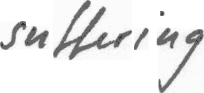
Problem Statement
While we are walking towards computerization, this application came to fill the gap between handwritten documents and computerized ones .
Simply the application takes an image of a hand written word and provide a computerized text of that word as an output.
suffering

Slide 3
Usage
A handwritten document could be easily edited .
There is no need to waste time in reading someone’s handwriting as you can just scan it .
People can read their prescriptions which are in general not understandable
Huge files in governmental institutions could be transformed to pdf documents which provide an easier way to search

Slide 4
Models
Rajib proposed a handwritten English character recognition system based on the Hidden Markov Model (HMM).
Velappa Ganapathy proposed a recognition method based on multi scale neural network training.
Serrano proposed a novel interactive approach for handwritten character recognition. The system requires human suggestion for only those inputs for which the system gets confuse.
Rakesh Kumar proposed a method in order to reduce the training time of the system by utilizing a single layer neural network. Segmented characters are scaled to 80 X 80 pixels.

Slide 5
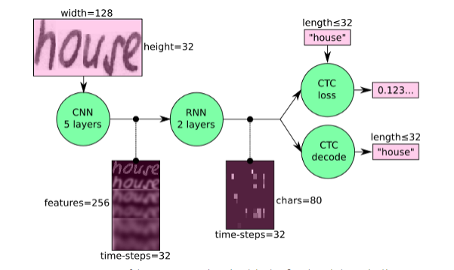
Selected Model
Neural Network (NN) which is trained on word-images from the IAM dataset.
It consists of convolutional NN (CNN) layers, recurrent NN (RNN) layers and a final Connectionist Temporal Classification (CTC) layer .
The model maps an image (or matrix) M of size W×H to a character sequence (c1, c2, …) with a length between 0 and L. the text is recognized on character-level.

Slide 6
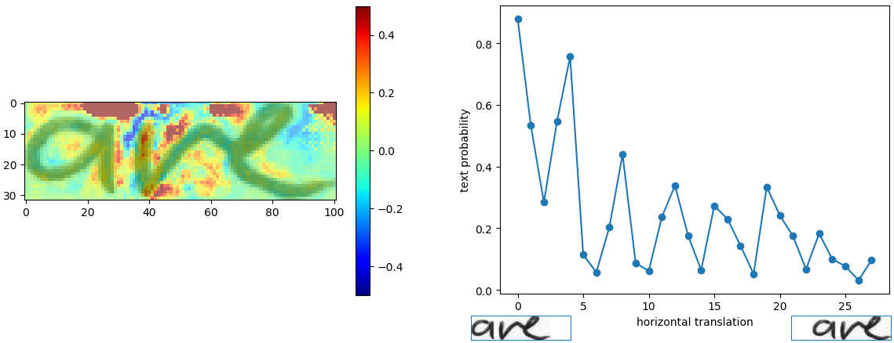
Problems in the model
The model is limited to word recognition
The following figure shows that when the word is aligned the accuracy is decreased

Slide 7
Modifications over the model
Using data augmentation to increase model’s accuracy
Studying the effect of trying different variations of CNNs like adding other layers or other architecture
Studying the effect of trying different variations of RNNs like 2D-LSTM and GRU
Developing the model to recognize a sentence image instead of one word image

Slide 8
Progress in proposed solutions
Adding data augmentation to the model :
Apply random align to the data image
Apply image rotation in random by max 20 degree
Apply resize method to decrease the size of the word

Slide 9
Where are we & next steps
Using data augmentation to increase model’s accuracy
Studying the effect of trying different variations of CNNs like adding other layers or other architecture
Studying the effect of trying different variations of RNNs like 2D-LSTM and GRU
Developing the model to recognize a sentence image instead of one word image

Slide 10
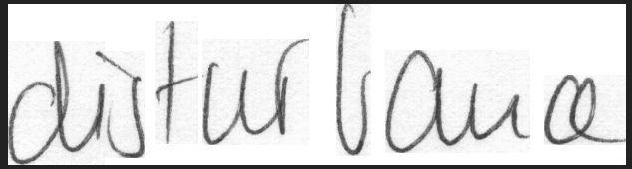

Initial Results
Input :
Output :
The system recognized the image with accuracy 0.4891021

Slide 11
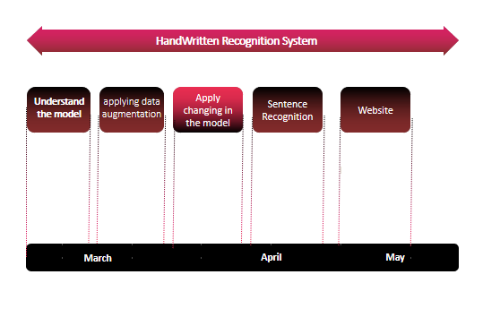
Timeline

Slide 12
Thank You

